Slide 1
Changes, Trends and Insights ESC 2024
Keith Landra, M.Sc.(A), P.Eng., CRSP
Chief Safety Officer
Canada Energy Regulator

Slide 2
Agenda
CER Safety Jurisdiction Review
Changes
Trends
Insights (and Priorities)

Slide 3
CER Safety Jurisdiction (Simplified)
Canada Energy Regulator
ESDC – Labour Program
Oil & Gas Ops Act (NWT)
Canada Oil & Gas Operations Act
Canadian Energy Regulator Act
Canada Labour Code – Part II
D&P Regs
Installation Regs
D&P Regs
Installation Regs
Onshore Pipeline Regs
DP Regs
Canada OHS Regs
Oil & Gas OHS Regs
Work Place H&VP Regs
Committees/Reps Regs

Slide 4
Changes – Onshore Pipeline Regulations (OPR)
Updating the OPR and Filing Manuals
Phase 1 engagement complete, Phase 2 engagement launching soon
Phase 2 will include several topic papers, including a focus on…
damage prevention
emergency management
human and organizational factors
management systems
process safety
pipeline integrity
reporting harm, including cyber events (loss of operational view/control)

Slide 5
Changes – Onshore Pipeline Regulations (OPR)
Your Feedback Matters via
CER Website
Information Sessions
Stay current by signing up for updates using the QR Code

Slide 6
Changes - Canada Labour Code – Part II
Pending - Amendments to Hazardous Substances Provisions in Regs
thermal stress, nanomaterials and non-solar ultraviolet radiation
updating radon requirement
clarifying ambiguous regulatory text to reflect best practices
updating out of date standards, and
improving consistency and harmonization with other provisions within the OHS Regulations
CG I publication occurred Oct 2023, CG II TBD
Pending – Toilet Room Counting… One-Gender vs All-Gender
OHS Regs expected to be amended allowing employers to count all-gender toilet rooms towards the total toilet room count requirement
The provision of an all-gender toilet room is not mandatory.

Slide 7
Changes – ACGIH TLV for Benzene
Changed - ACGIH TLVs (e.g. COHS Section 10.19)
Benzene
ACGIH TWA = 0.02 ppm (Alberta, BC = 0.5 ppm)
ACGIH STEL = 0.1 ppm (Alberta, BC = 2.5 ppm)

Slide 8
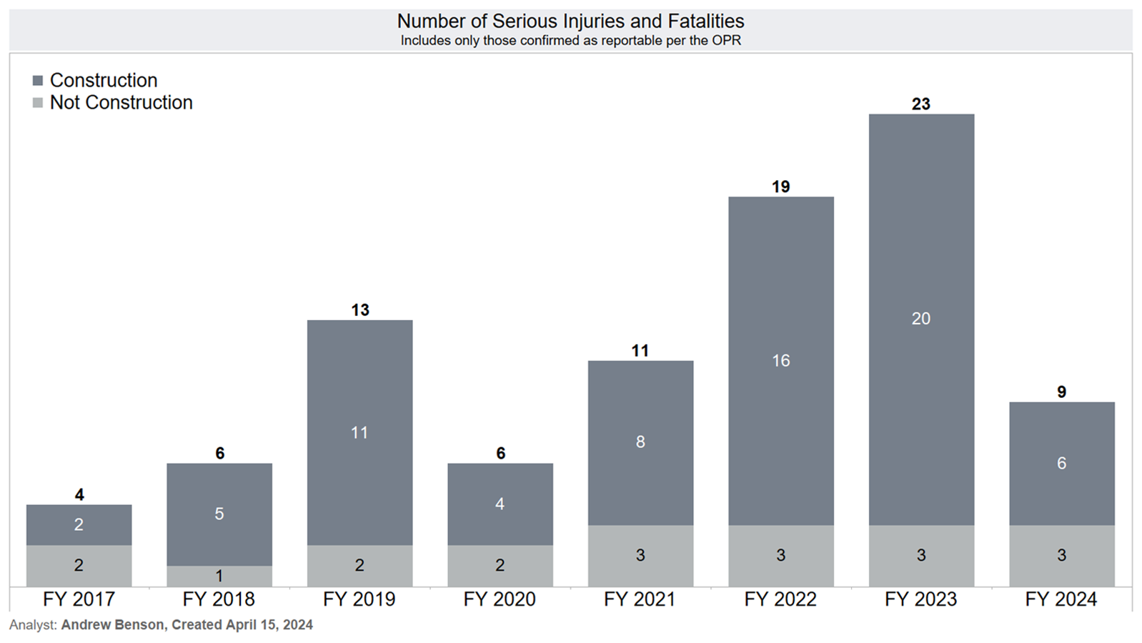
Trends – Serious Injuries and Fatalities

Slide 9
Insights … Improving Our Oversight
Occupational Hygiene
Monitoring regulatory changes on managing worker exposures (e.g. adoption of new benzene TLV)
Advancing improvements in hazard identification, exposure elimination and controls. Continuing enforcement to referenced CSA standards.
Contractor Oversight (by Regulated Companies)
Clarifying requirements through company engagement and developing guidance documentation
Assisting regulated companies to become compliant with the OPR by advancing improvements in regulated company oversight of their contractors’ work

Slide 10
Insights … Improving Our Oversight
Process Safety Management
Continues to be integrated into CER safety compliance oversight activities through Information Exchange meetings, field inspections focusing on HAZOPs/PHAs and their implementation, and the improvement of PSM staff / competency
Increased compliance activity to explore, clarify, and set process safety expectations. CER is re-focusing on O&M activities which includes benchmarking to CSA Z662 and Z767
CSA Z767 – Process Safety Management Standard
Participation in the CSA Technical Committee
Adherence to a particular PSM standard is not currently a regulatory requirement

Slide 11
Insights … Improving Our Oversight
Damage Prevention
Continue to engage regulated companies on…
how they manage direct contractors …
and engage with third parties …
and engage the general public …
to ensure that those working and living around federally regulated pipelines understand the hazards and their respective responsibilities.

Slide 12
Insights – Supporting Continuous Improvement
Safety Culture and Human and Organizational Factors
Continue industry dialogue, sharing and collaboration through annual workshops and other outreach activities
Continue development of practical resources, support materials, data dashboard, guidance documents accessible on CER external website (Safety Culture Learning Portal) with new e-learning modules on the way (Safety Culture 101 content)
Continue internal and external socialization of HOF (HOP) including value of CSA EXP16 entitled Human and Organizational Factors for Optimal Pipeline Performance

Slide 13
Q&A to Follow Keith.Landra@cer-rec.gc.ca

